Slide 1
Javascript, Canvas in JQuery
Milan Ojsteršek

Slide 2
Javascript example
<!DOCTYPE html>
<html>
<body>
<p id="demo">Click the button to change the text in this paragraph.</p>
<button onclick="myFunction()">Try it</button>
<script>
function myFunction() {
document.getElementById("demo").innerHTML = "Hello World";
}
</script>
</body>
</html>

Slide 3
Features of Javascript
Javascript has C++ „like“ syntax
Javascript is dynamic typing language – see also Javascript conversion
Javasript reacts to events
Javascript is object oriented language
  JavaScript Can Change HTML Content
  JavaScript Can Change HTML Attributes
  JavaScript Can Change HTML Styles (CSS)
JSON is a format for storing and transporting data ( read also about JSONP)

Slide 4
Input and output in Javascript
Input in Javascript
  window.prompt, Javascript conversion
  window.confirm
  input in HTML and form validation
Output in Javascript
  document.write
  window.alert
  console.log
  writing into HTML

Slide 5
Javascript basics
<button onclick="myFunction()">Try it</button>
<p id="demo"></p>
<script>
function myFunction() {
var text = ""
var i = 0;
do {
text += "<br>The number is " + i;
i++;
}
while (i < 5);
document.getElementById("demo").innerHTML = text;
}
</script>
Variables Operators
Statements
(if, switch, for, while,
break)
Functions ( scope )
Objects

Slide 6
Predefined objects
_x000b_Global
String (reference)
Number (reference)
Math (reference)
Date (reference)
Array (reference)
Boolean
Error (reference)
RegExp (reference)
<button onclick="myFunction()">Try it</button>
<p id="demo"></p>
<script>
function myFunction() {
var x = 10;
var y = 20;
var a = eval("x * y") + "<br>";
var b = eval("2 + 2") + "<br>";
var c = eval("x + 17") + "<br>";
c=c+eval("alert('Be carefull');");
var res = a + b + c;
document.getElementById("demo").innerHTML = res;
}
</script>

Slide 7
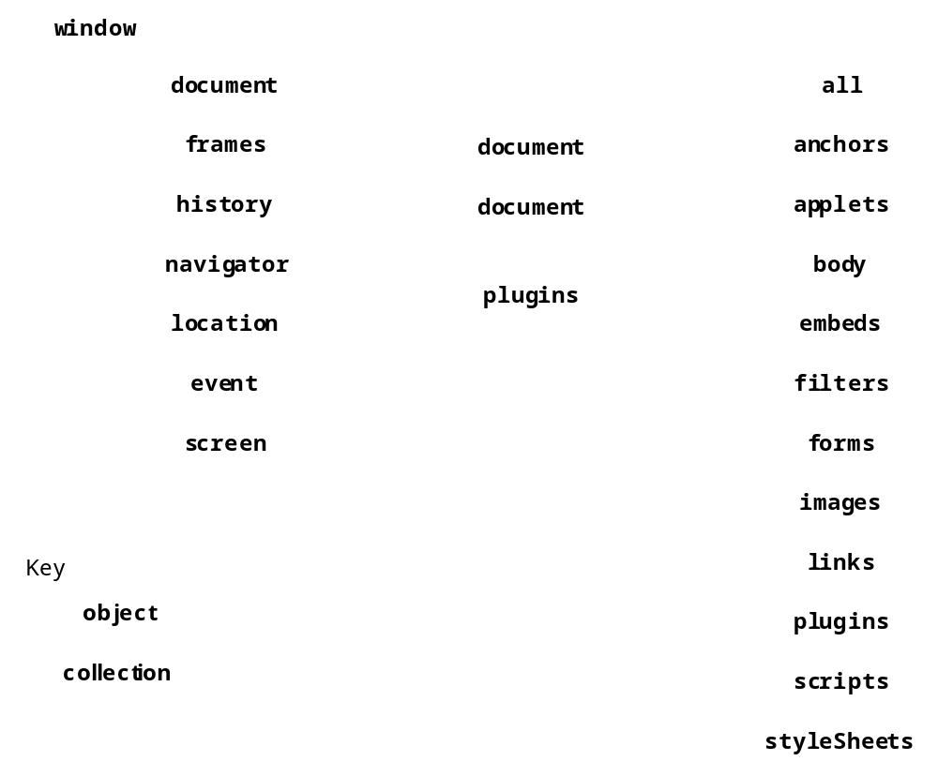
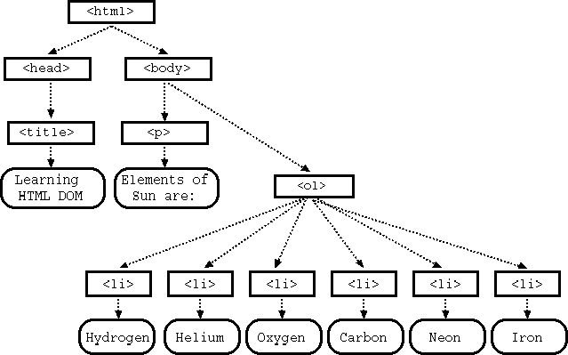
DOM object model

Slide 8
The Browser object model
Window
Screen
Location
History
Navigator
Cookies
Timing

Slide 9
HTML DOM objects
document
  document.getElementById()
  document.getElementsByClassName()
  document.getElementsByName()
  document.getElementsByTagName()
HTML elements
HTML attributes
HTML events
CSS styles

Slide 10
HTML CANVAS
Drawing in CANVAS (rectangle, line, circle, gradients, text, images).
CANVAS reference
CANVAS clock example
CANVAS game example
HTML Canvas element:
<canvas id="myCanvas" width="200" height="100"style="border:1px solid #000000;"></canvas>
Drawing with Canvas:
1. Find the Canvas Element:
var canvas = document.getElementById("myCanvas");
2. Create a Drawing Object:
var ctx = canvas.getContext("2d");
3. Draw on the Canvas:
ctx.fillStyle = "#FF0000";
ctx.fillRect(0,0,150,75);

Slide 11
jQuery
<script src="https://ajax.googleapis.com/ajax/libs/jquery/3.2.1/jquery.min.js"></script>
<script>
$(document).ready(function(){
$("p").click(function(){
$(this).hide();
});
});
</script>

Slide 12
JQuery selectors
$("#test")
$(".test")
$("p.intro")
$("p:first")
$("ul li:first")
$("[href]")
$("a[target='_blank']")

Slide 13
jQuery Event Methods
$("p").click(function(){
alert("The paragraph was clicked.");
});
$("p").hover(function(){
$(this).css("background-color", "yellow");
}, function(){
$(this).css("background-color", "pink");
});
jQuery Events reference

Slide 14
jQuery Effects
Hide and show elements:
$("#hide").click(function(){_x000b_ $("p").hide();_x000b_});_x000b__x000b_$("#show").click(function(){_x000b_ $("p").show();_x000b_});
Fade in
$("button").click(function(){_x000b_ $("#div1").fadeIn();_x000b_ $("#div2").fadeIn("slow");_x000b_ $("#div3").fadeIn(3000);_x000b_});

Slide 15
Callback
$("button").click(function(){
$("p").hide("slow",function(){
alert("The paragraph is now hidden");
});
});

Slide 16
Chaining
$(document).ready(function()
{
$("button").click(function(){
$("#p1").css("color","red").slideUp(2000).slideDown(2000);
});
});

Slide 17
jQuery - Set Content and Attribute
$("#btn1").click(function(){
$("#test1").text("Hello");
});
$("#btn2").click(function(){
$("#test2").html("<b>Hello!</b>");
});
$("#btn3").click(function(){
$("#test3").val(„Hello");
});

Slide 18
jQuery - Add Elements
$("p").append("Some appended text.");
$("p").prepend("Some prepended text.");
$("img").after("Some text after");
$("img").before("Some text before");

Slide 19
jQuery - Get and Set CSS Classes
$("p").css("background-color","yellow");
$("button").click(function(){
$("#div1").addClass("important blue");
});
$("button").click(function(){
$("h1,h2,p").removeClass("blue");
});

Slide 20
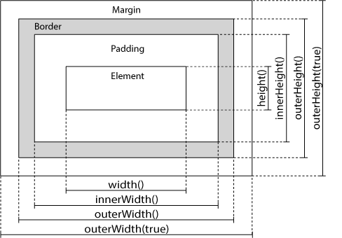
jQuery - Dimensions
$("button").click(function(){
$("#div1").width(500).height(500);
});

Slide 21
Traversing the DOM
$(document).ready(function(){
$("ul").children().css({"color":"red","border":"2px solid red"});
});
$(document).ready(function(){
$("span").parent();
});
$(document).ready(function(){
$("h2").siblings("p");
});

Slide 22
jQuery - Filters
$(document).ready(function(){
$("div p").first().css("background-color","yellow");
});
$(document).ready(function(){
$("p").eq(1);
});
$(document).ready(function(){
$("p").filter(".intro");
});

Slide 23
Write a Javascript code, that shows a browsers pop-up window to a user for input of a string. Save the input to the variable called x. Check if inputed string contains a capital letter. If not, display a browsers pop-up window with a warning.
Write a javascript code, that adds link to the FERI website (http://feri.um.si) to the HTML element below.
<td id='141'></td>
Write a Javasctript code, that writes a code to the HTML document. The code should display unordered list with 15 elements. As the content of the list, print 'Element X', while putting the number of item instead of 'X'.

